Slide 1

Why Control?
Control is an issue every manager faces.
How does control help the manager?
  Control is a process to regulate organizational activities to make them consistent with established:
    Plans
    Targets
    Standards

Slide 2
The Purpose of Control
Adapt to
environmental change
Limit the
accumulation of error
Control helps the organization
Cope with organizational
complexity
Minimize costs

Slide 3
Levels of Control
Operational control:
  Focuses on the processes used to transform resources into products or services.
Financial control:
  Concerned with financial resources.
Structural control:
  How the elements of structure are serving the intended purposes.
Strategic control:
  How effective are the functional strategies helping the organization meet its goals.

Slide 4
What Are the Steps in the Control Process?
Establish standards.
Measure performance.
Compare performance against standards.
Determine need for corrective action.
The sub-steps:
  Maintain status quo.
  Correct deviation.
  Change standards.

Slide 5
What Does Preliminary Control Monitor?
It attempts to monitor quality and quantity of:
  Financial resources.
  Material resources.
  Human resources.
  Information resources.
Why?
  Before they become part of the system.
  What Is the Purpose of Screening Controls?
They focus on how inputs are being transformed into outputs.
They also rely heavily on feedback processes during the transformation process.

Slide 6
What Do Post-action Controls Focus On?
Focus is on outputs from the organizational system.
What do they monitor?
  They monitor the output results of the organization after the transformation process is complete.
  (see Figure 20.4 illustration)
  Who Is Responsible for Control?
Control rests with all managers.
Large corporations have a controller.
What does a controller do?
  Helps line managers with their control activities.

Slide 7
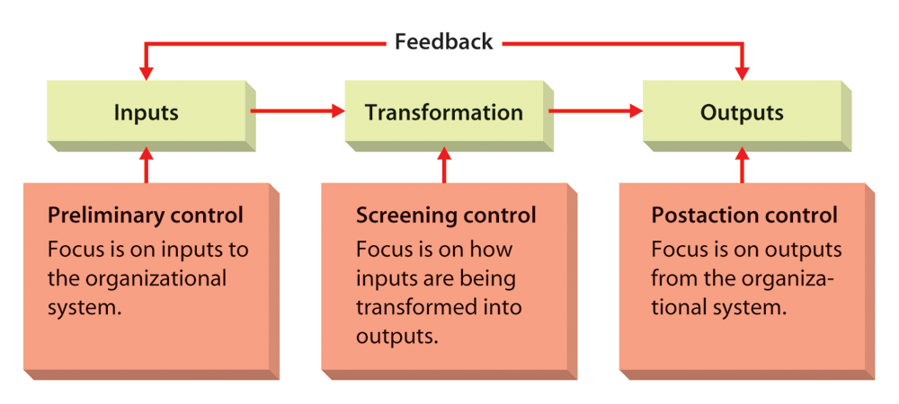
Forms of Operational Control

Slide 8
What Are the Reasons for Financial Controls?
They control the financial resources as they flow into the organization.
Then they are held by the organization.
Then they flow out of the organization.
Businesses must manage their finances so that revenues are sufficient to cover expenses and still return a profit.

Slide 9
What Is a Budget?
It is a plan expressed in numerical terms.
What is the time frame for a budget?
  Usually a year, but sometimes broken down into quarters and months.
Budgets are quantitative in nature and provide yardsticks for measuring performance and facilitating comparisons.
Types of Budget
Types of budget:
  Financial
  Operating
  Non-monetary
What budget shows?
What the budget shows:
  Sources and use of cash.
  Operations in financial terms.
  Operations in non-financial terms.

Slide 10
Other Tools for Financial Control
Financial Statement:
A profile of
some aspect of an
organization’s financial
circumstances.
Balance Sheet: List of assets and liabilities of an organization at a specific point in time, usually the last day of the fiscal year.
Income Statement: A summary of financial performance over a period of time, usually one year.
Ratio Analysis: The calculation of one or more financial ratios to assess some aspect of the organization’s financial health.
Audit: An independent appraisal of an organization’s
accounting, financial, and operational system.

Slide 11
What Is Bureaucratic Control?
A form of organizational control characterized by formal and mechanistic structural arrangements.
What is clan control?
  An approach to organizational control characterized by informal and organic structural arrangements.

Slide 12
What Is Meant by Strategic Control
Control aimed at ensuring that the organization is maintaining an effective alignment with its environment and moving toward achieving its strategic goals.
* Integration
with planning
* Flexibility
* Accuracy
* Timeliness
* Objectivity

Slide 13
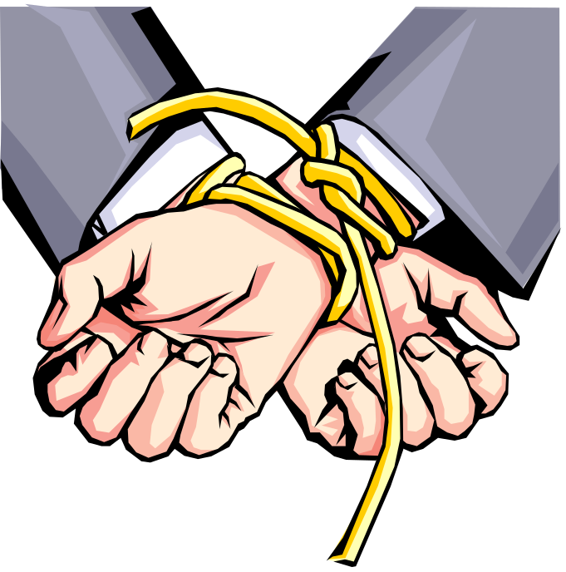
What Influences Resistance to Control?
Over-control
Inappropriate focus
Rewards for inefficiency
Too much accountability
Overcoming the Resistance to Control
When employees are involved with planning and implementing the control system, they are less likely to resist.
Verification procedures need to be developed to provide checks and balances in order for managers to verify the accuracy of performance indicators.

